Slide 1

Project Updates
Cybersecurity Assessment Report Automation Tool

Slide 2
ABOUT:
Dramatically cut the reporting time by quickly and easily merging output from multiple tools into one professionally designed report.
Multi-User reporting Manage reusable cybersecurity assessment and Vulnerability Data
Combine multiple output into one professionally designed report. And place the description in its assigned place and arrange it accordingly.

Slide 3
Features:
Advanced Custom Reporting: Dramatically cut the reporting time by quickly and easily merging output from multiple tools into one professionally designed report.
Quality and Consistency: Use one of these methodologies to ensure consistent results.
Manage reusable cybersecurity assessment and Vulnerability Data
Features

Slide 4

Interface of the Tool:
Dynamic Dashboard
With round dynamic graph
Enable to post some comments and solutions for the uploaded pdf reports from the history table
Able to upload POC (proof-of-concept) with multiple image format.
All Issues -> by clicking this option a window will open where user have to enter the detail in description
Store the History of the generated report in form of table

Slide 5
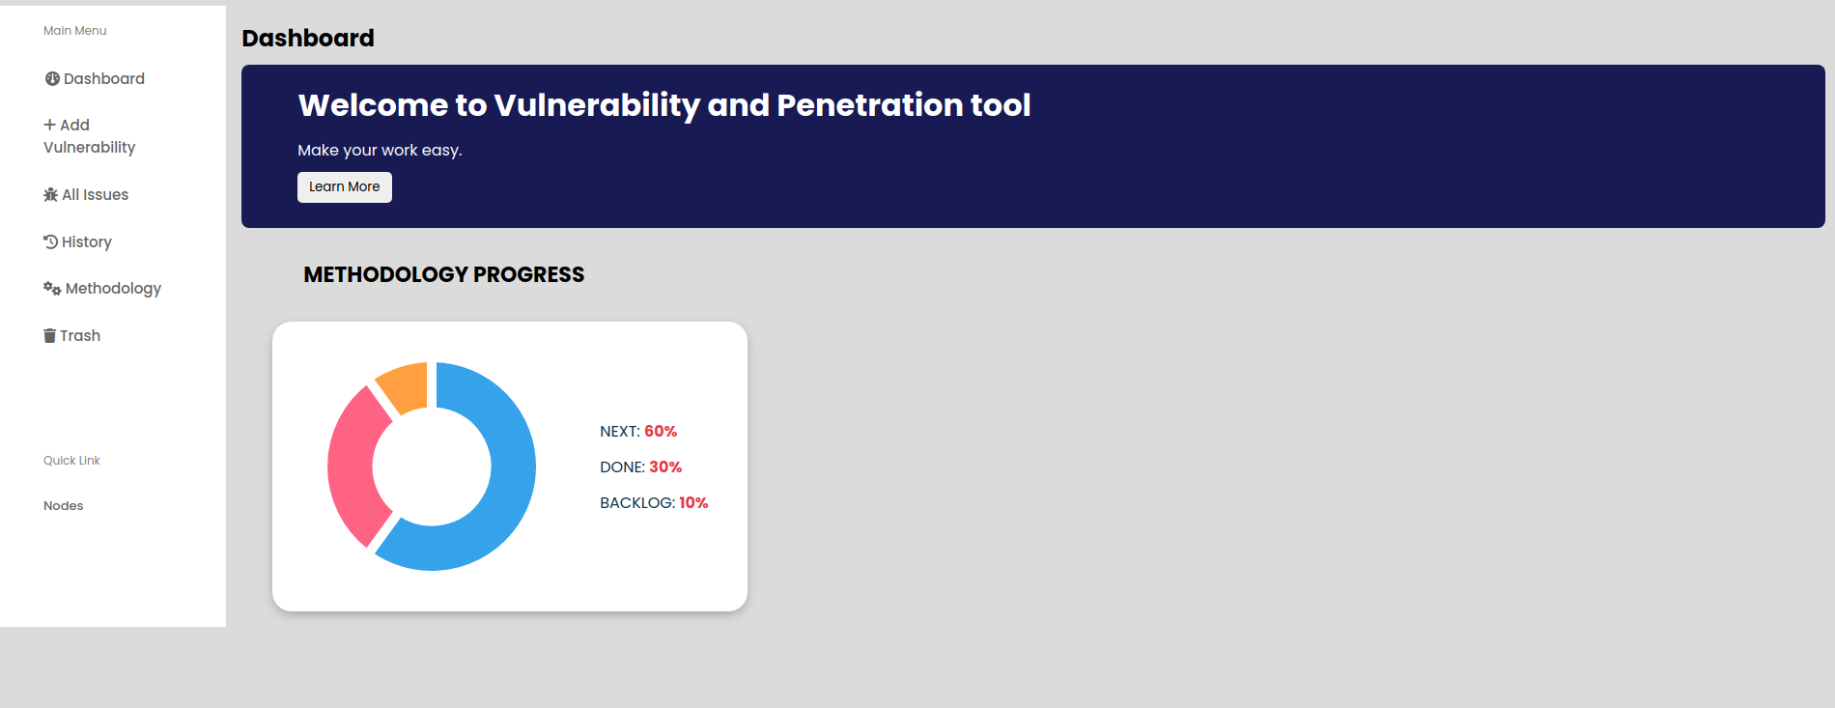
Interface of the Tool:

Slide 6
Assigned work for me:
To make the History table and dynamic round graph
Connecting to the generated Pdf with backend server using MySQL database
Uploading of multiple image file for POC

Slide 7
Conclusion
Cybersecurity Assessment Report Automation Tool can provide a comprehensive and efficient way to identify and prioritize vulnerabilities in a system
it can save time and resources while providing a more accurate and up-to-date assessment of the system’s security.
tools should be used in conjunction with other security measures and multiple user used it at a time
1
2
3

